Slide 1
Full Application Voice Changer

Slide 2
Core Features
Record your voice
Apply effects (10 effects for voice)
Save and share voice
View your records
Beautiful UI
Admob support
Material Design
Set voice as ringtone or notification sound

Slide 3
Setup Develop Tools
Let download and install Android Studio via this link
https://developer.android.com/sdk/index.html

Slide 4
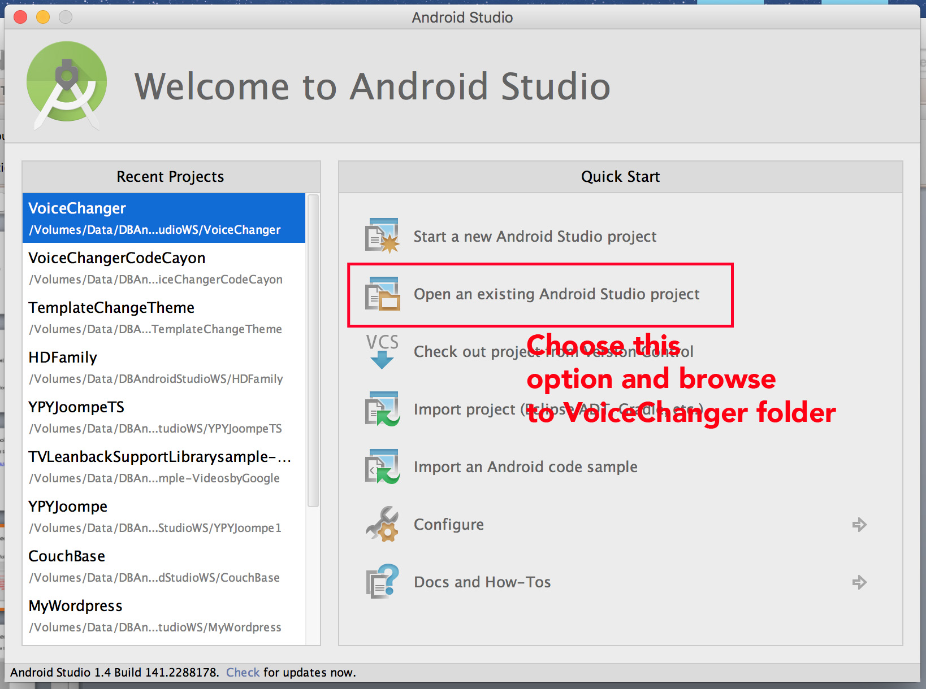
Step 1: Setup Project
Extract file “codecayon-xxxx.zip”
Import project in VoiceChanger folder to Android Studio

Slide 5
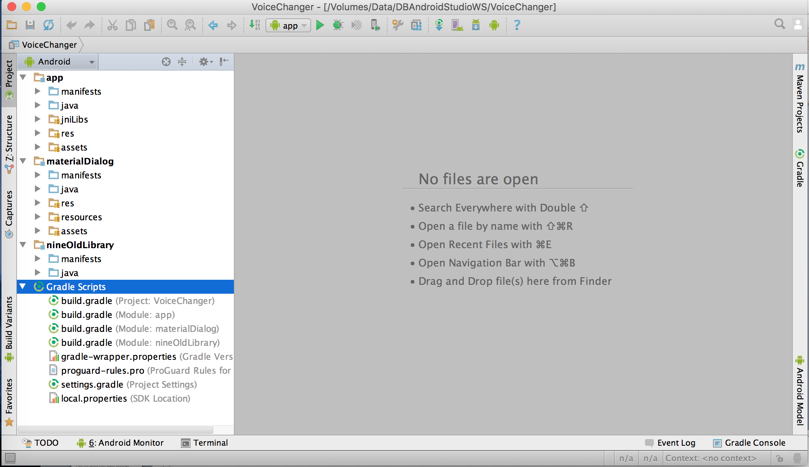
Step 1: Setup Project
After importing done.You can see this workspace

Slide 6
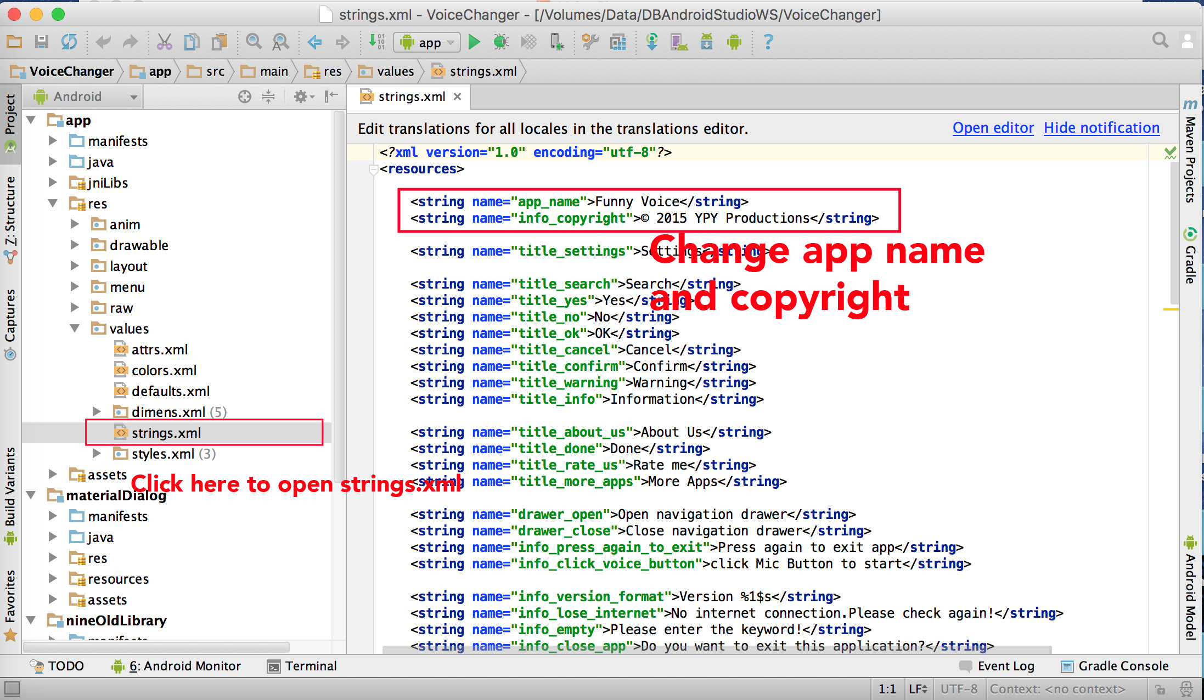
Step 2: Configure Project
Change to your app name, and copyright text in res/values/strings.xml

Slide 7
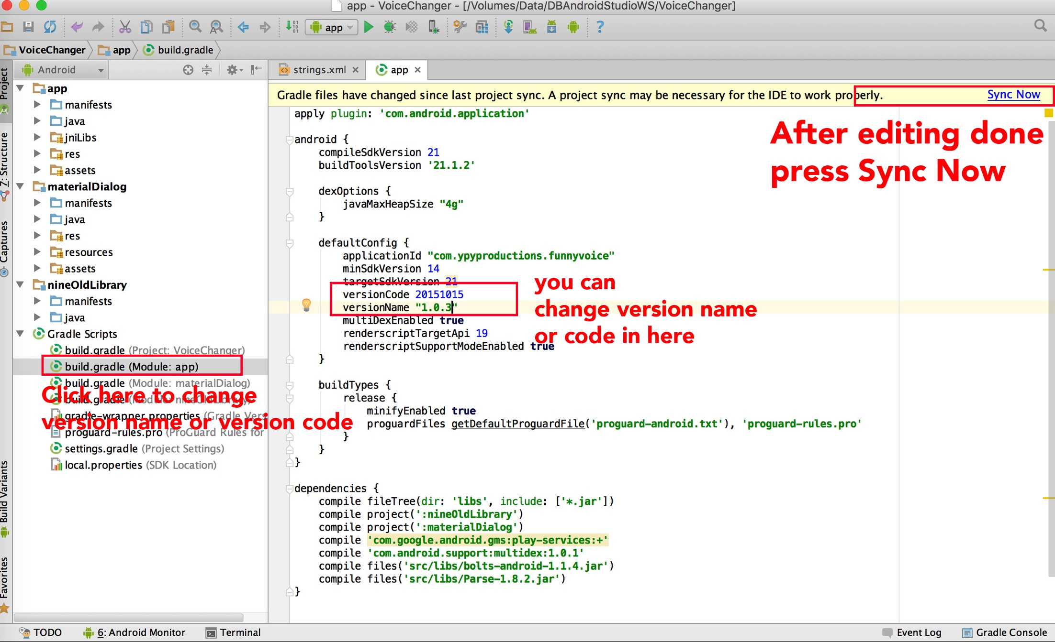
Step 3: Change version code or version name
To change version code or version name, You must to go build.gradle file.You can see the below image

Slide 8
Step 4: Setup your datas
Open class IVoiceChangerContants.java in package com.ypyproductions.voicechanger.constants
You can see some params.We will configure it

Slide 9
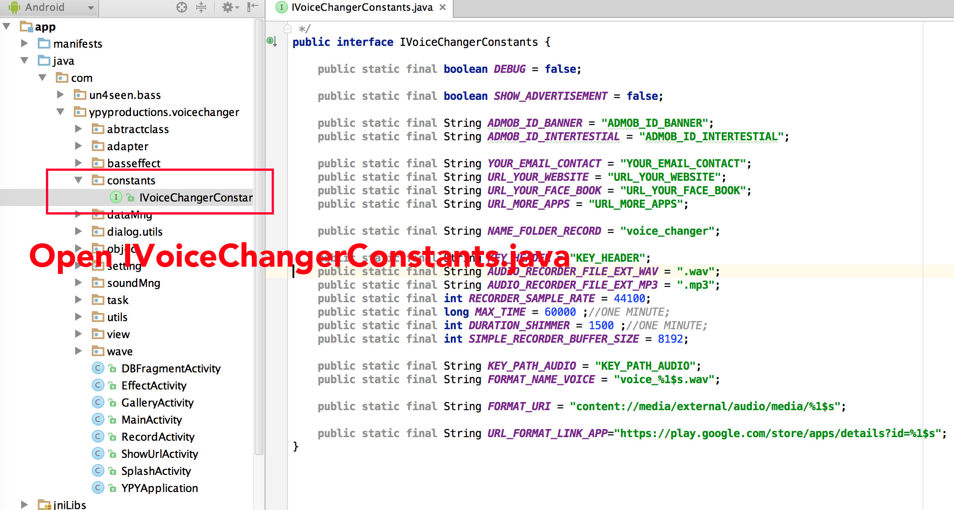
Step 4: Setup your datas

Slide 10
Step 4: Setup your datas
YOUR_EMAIL_CONTACT: your email contact
URL_YOUR_WEBSITE: url of your website
URL_YOUR_FACE_BOOK: url of your facebook
URL_MORE_APPS: The publisher url on google play for more apps
NAME_FOLDER_RECORD : The destination folder when saving your record
SHOW_ADVERTISEMENT : Let it to be true if you want to show advertisment, vice versa…
ADMOB_ID_BANNER: Your admob banner id
ADMOB_ID_INTERTESTIAL: your admob intertesitial id

Slide 11
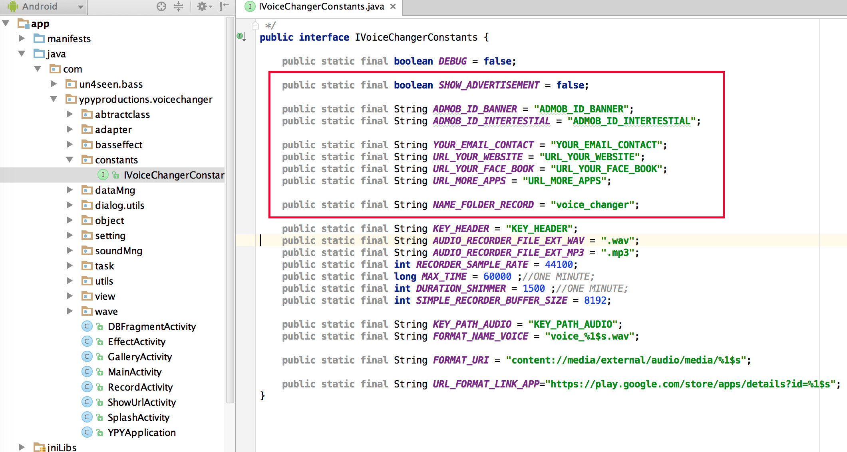
Step 4: Setup your datas

Slide 12
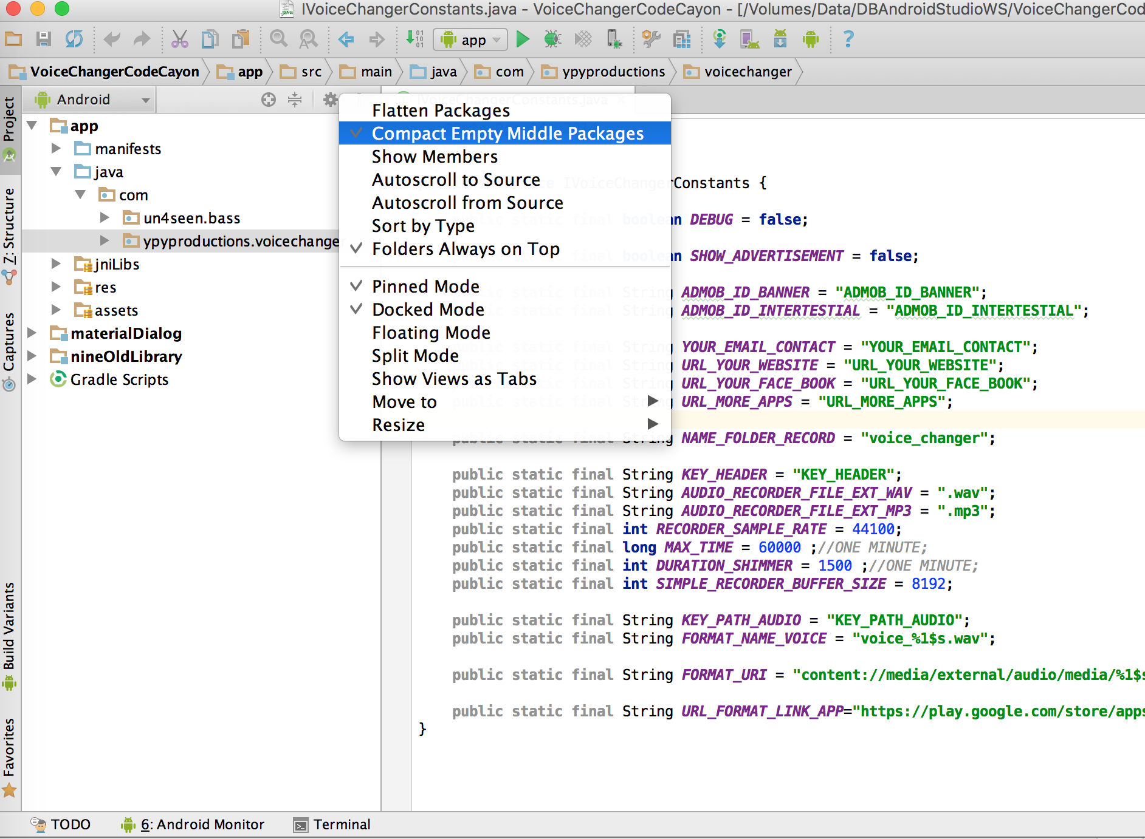
Step 5: Change packagename
Click to package com.ypyproductions.voicechanger
Uncheck Compact Empty Middle packages

Slide 13
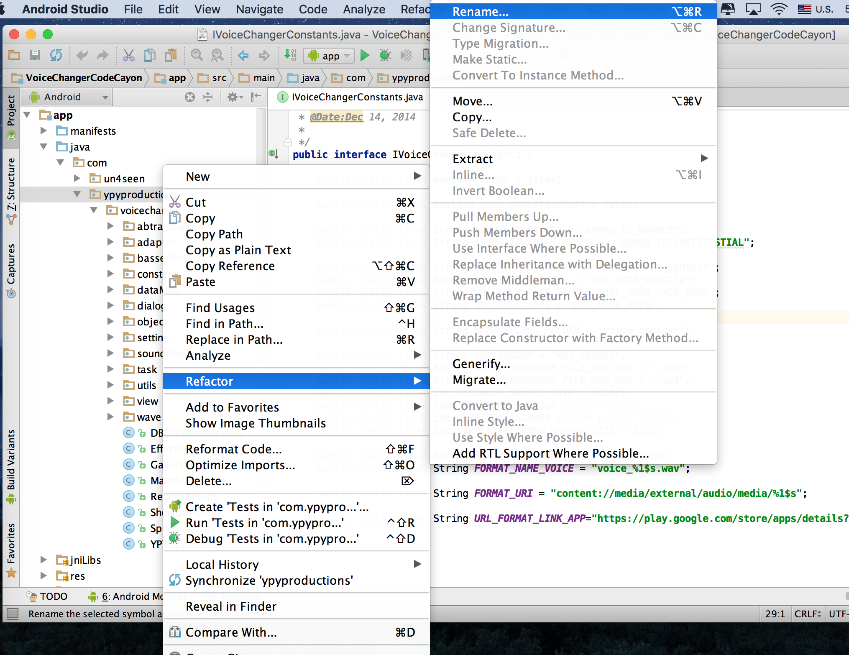
Step 5: Change packagename
Right mouse to ypyproductions, Select Refactor/Rename

Slide 14
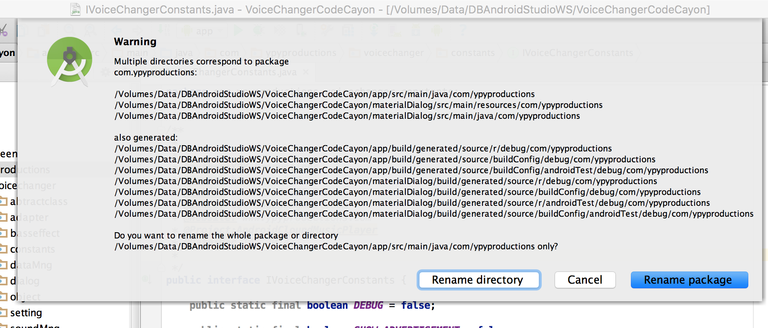
Step 5: Change packagename
One warning dialog will show.Please select rename package

Slide 15
Step 5: Change packagename
Let rename to your name
The same way for voicechanger package if you want to change more
You can refer more ways to change packagename in Android Studio
http://stackoverflow.com/questions/6600329/how-do-i-rename-the-android-package-name
https://www.youtube.com/watch?v=A-rITYZQj0A

Slide 16
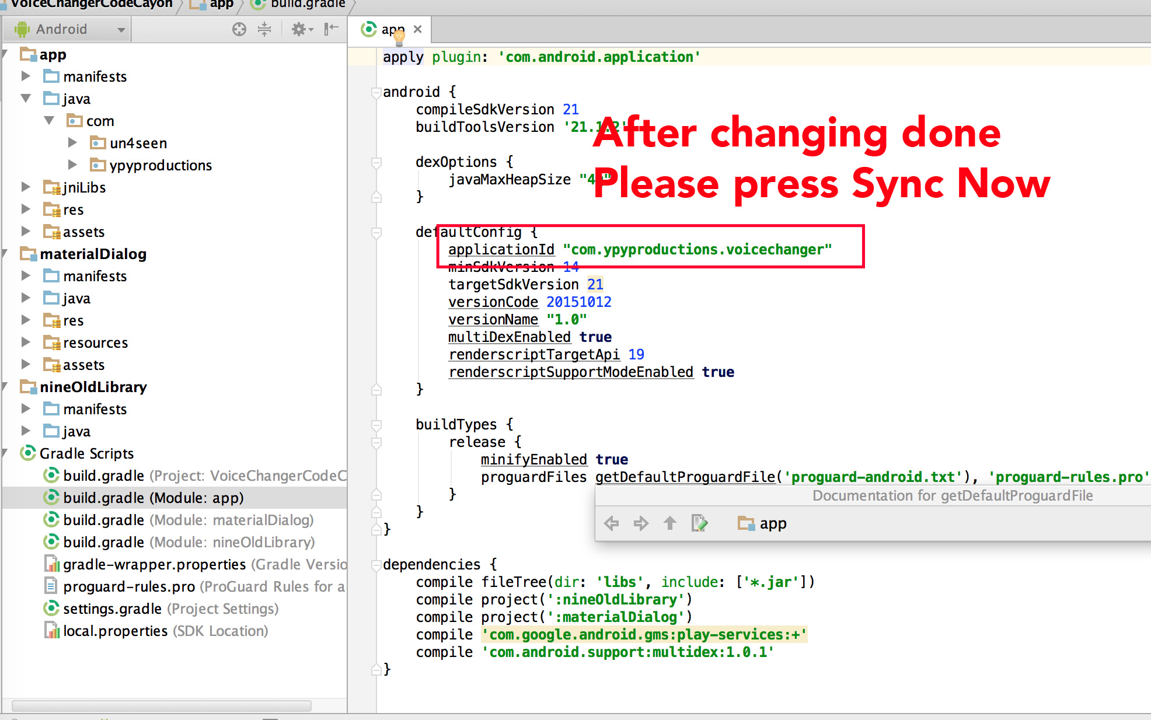
Step 5: Change packagename
After changing packagename done, Please change your applicationid in build.gradle

Slide 17
Step 6: Translate Project To Your Language
Open strings.xml in res/values and translate
For examples:
<string name="title_confirm">Confirm</string>
You only allow to change “Confirm” word.Dont translate “title_confirm”
With the string format for examples:
<string name="info_version_format">Version:%1$s</string>
You only allow to change Version word and keep %1$s string

Slide 18
Step 7: Change Icon of Application
To change icon app, let replace file ic_launcher.png in 4 folders and keep size of this image
res/xxhdpi : size 144x144px
res/xhdpi : size 96x96px
res/hdpi: size 72x72 px
res/mdpi: size 48x48px

Slide 19
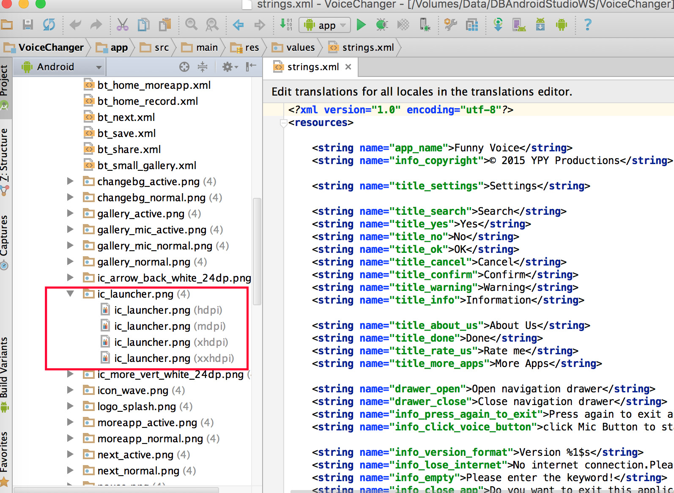
Step 7: Change Icon of Application

Slide 20
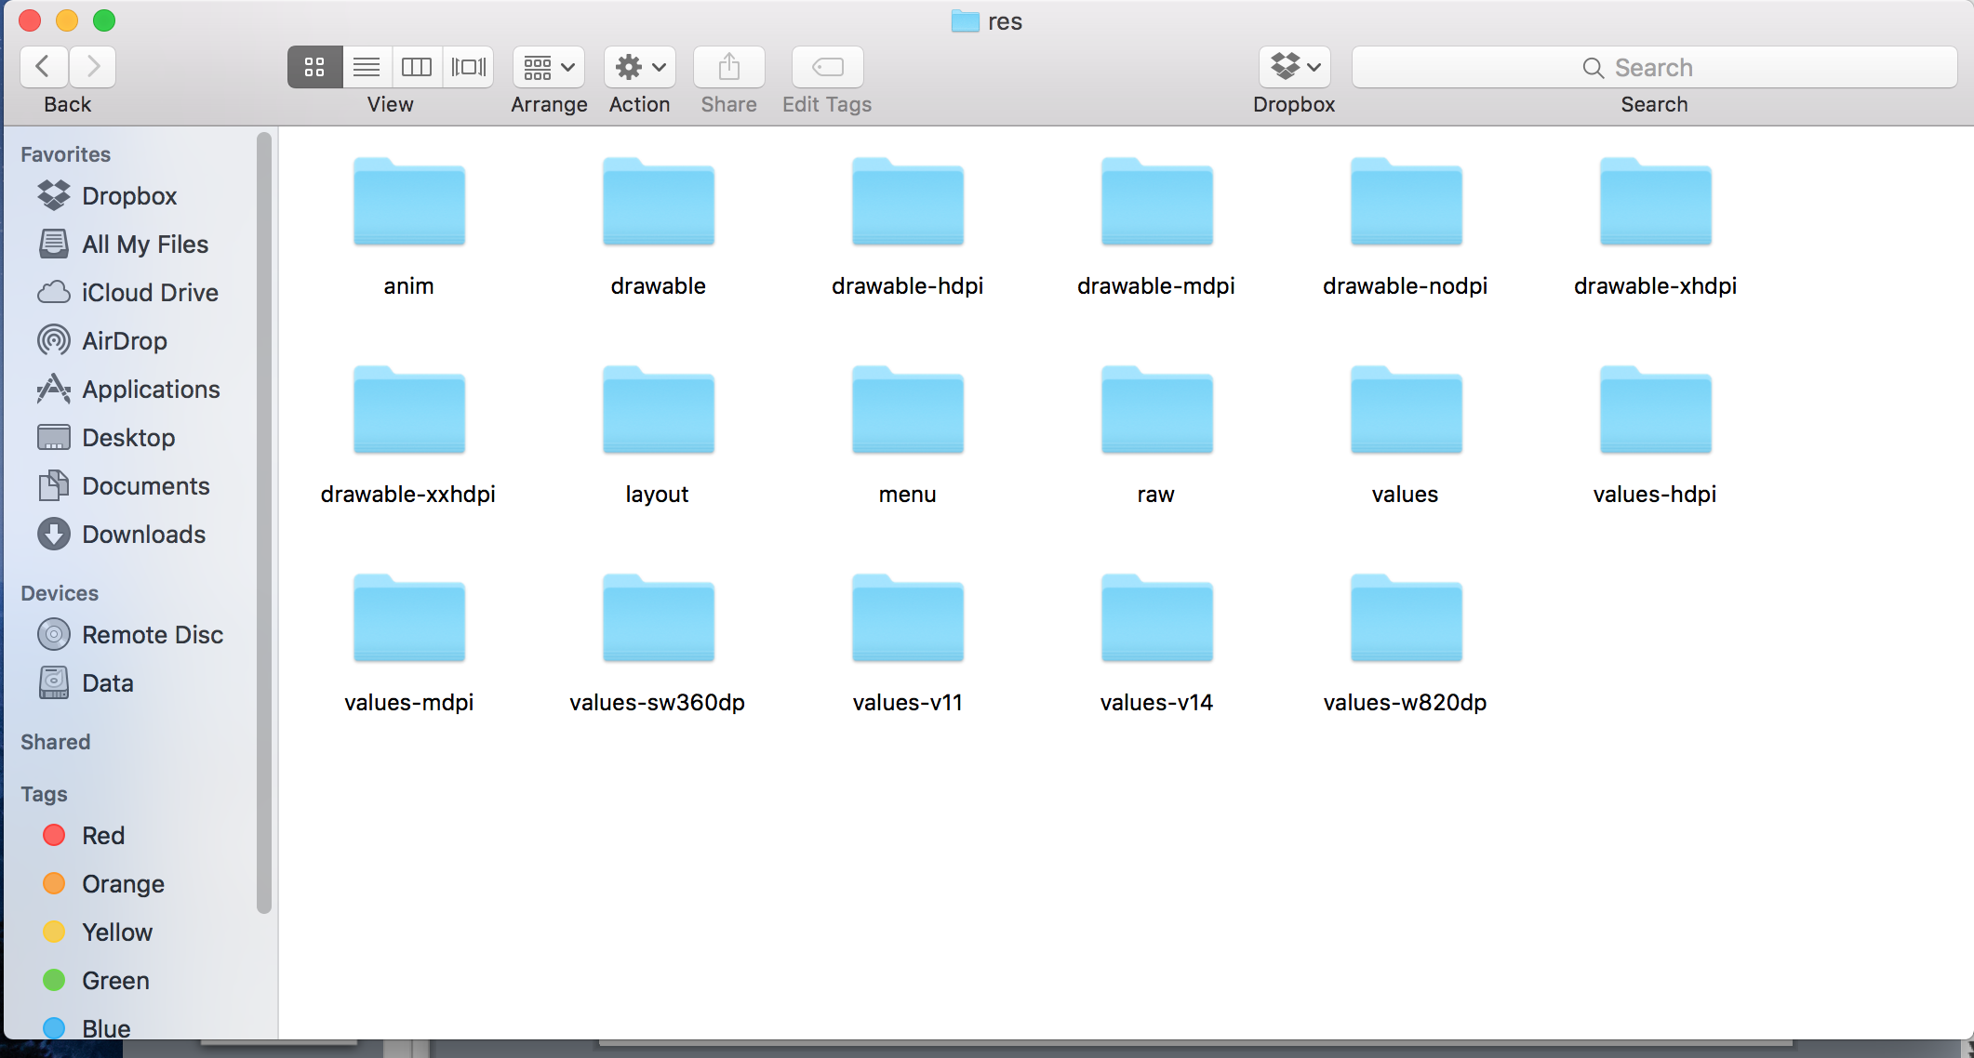
Step 7: Change other icons of Application
To change other icons of application.Let go to your folder VoiceChanger/app/src/main/res

Slide 21
Step 7: Change other icons of Application
You can see 4 folders
drawable-xxhdpi
drawable-xhdpi
drawable-mdpi
drawable-hdpi
Let see all icons in those folders, and replace it to your icon.Please keep icon size as the old image

Slide 22
Step 8: Export APK
To export apk to publish to google play
From android studio select Build/Generate signed apk
Select your keystore and want to export it.If you did not have any keystore, you can create it from this dialog
It same as eclipse

Slide 23
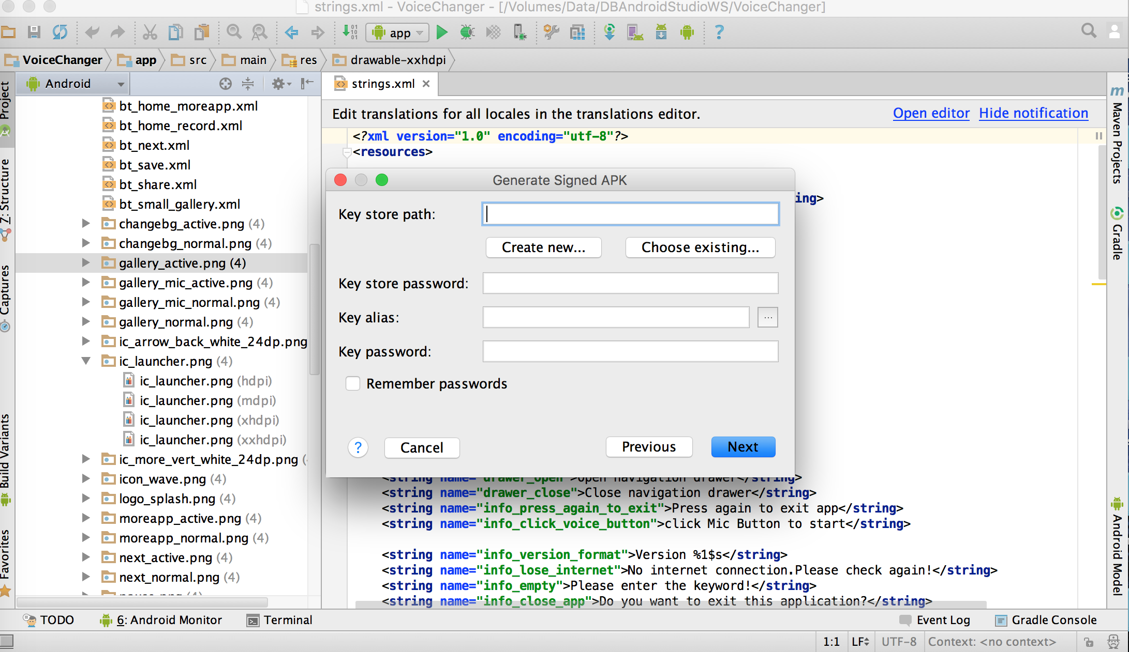
Step 8: Export APK

Slide 24
Step 8: Run Project
After setting up project finishing, you can run and install application.
If you have any problem about this project.Please send email to me.My email is baodotrung@gmail.com

Slide 25
HOPE YOU ENJOY IT.THANK YOU

